Slide 1
CINning with the machines
Kelly Brock
Takeda Fall Group Meeting 12/11/2015

Slide 2
This week’s projects
Exploring HIV literature
CIN simulations – state machine model
NAMD troubleshooting

Slide 3
Simulating tetraploidy jumps to explain bimodality
m1
m2
m3
. . .
2N-1
2N
2N+1
2N+2
4N
ki

Slide 4
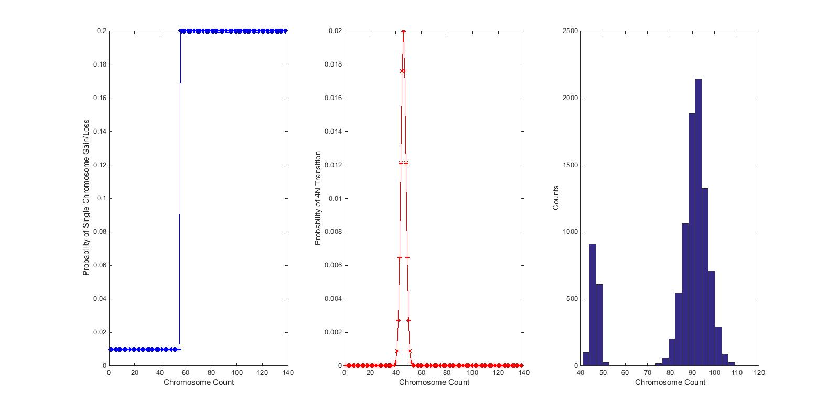
From last week – we can get bimodal distributions

Slide 5
Strategies for varying m and k values
Non-linear optimization
  Maximize correlation of end state distribution with SKY data
  Assume k-distribution
Direct parameter sweep
  Can vary both m and k

Slide 6
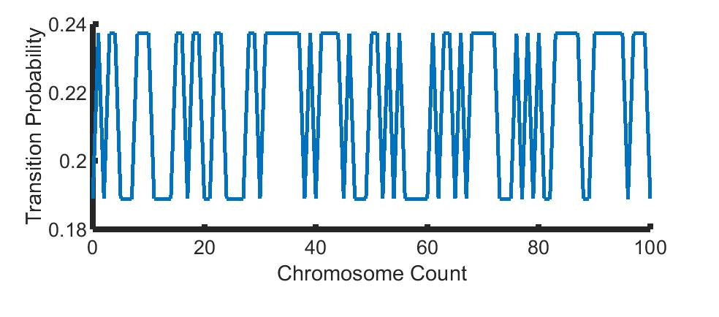
First trial of optimization
Good: tracks with known CIN values
Not so good: Higher missegregation not correlated with higher chromosome counts

Slide 7
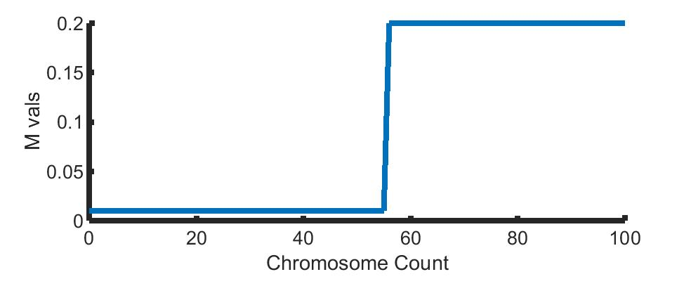
M vals optimal – first pass parameter sweep

Slide 8
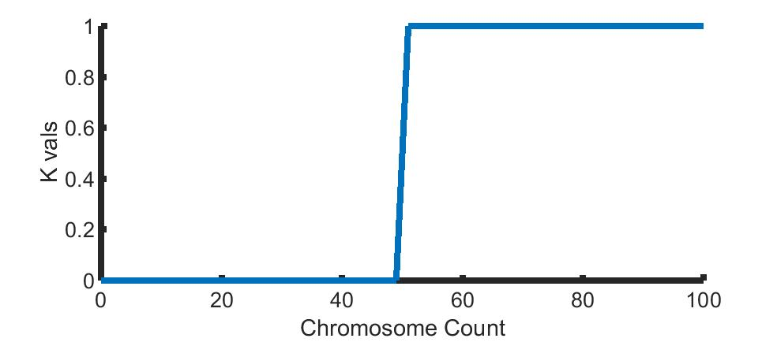
K vals optimal – first pass parameter sweep

Slide 9
Caveats
Optimization not, well, optimal – rerunning with finer control now, should be done over weekend
K and M vals – correlation not best predictor, memory constraints

Slide 10
Going over multiple distributions
Iterating over flat, sigmoid, gaussian distributions for both m and k
Find which one is closest to SKY data fit

Slide 11
Molecular Dynamics Updates
Have been debugging
  Goal is to have initial mutation relaxation done by next week
Using NAMD and VMD
Working through tutorial, biggest focus next week

Slide 12
This week
Finish running param sweep
MD!!! And getting set up on cluster

